Slide 1
Superstore Sales Dashboard
Abhishek Kumar Master of Operational Research University of Delhi Gmail:- 081abhishek@gmail.com File created on: 30-01-2024 18:21:07

Slide 2
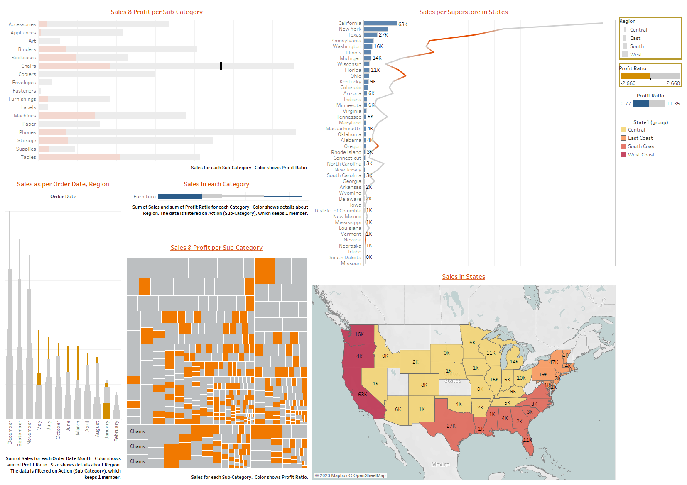

Slide 3
Insights:-
The three worst performing sub-categories in their region in terms of Sales:- (i) Fasteners – In South region, 3024 sales which can further be divided as - Only 2 sales in ‘Wisconsin’ which has only ONE Superstore having Profit ratio of 0.36. - The sales are very less in January. (ii) Envelopes – In South region, 16477 sales which can further be divided as - Only 2 sales in ‘Vermont’ which has only ONE Superstore having Profit ratio of 0.47. - The sales are very less in June. (iii) Labels - In South region, 12507 sales which can further be divided as - Only 7 sales in ‘Arkansas’ which has only ONE Superstore having Profit ratio of 0.47. - The sales are very less in January.

Slide 4
Managers Questions
How does your visualization leverage at least one “pop-out effect” or “pre-attentive attribute?” Which one(s) was (were) chosen and why? My visualization leverages ‘pop-out effect’ because I’ve chosen Color, Sizes, and Shapes attributes.
How does your visualization utilize at least one Gestalt principle? Which principle(s) is (are) being reflected, and how? My Visualization utilizes Proximity, Enclosure, and Continuity. Enclosure principle using the color or boundaries to highlight or contrast information. Proximity principle as grouped sales for each sub-category where color shows Profit Ratio. Continuity principle in showing Sales per Superstore in States and using trend lines of Profit ratio and number of superstore.
How does your design reflect an understanding of cognitive load and clutter? My design reflect an understanding of cognitive load and clutter since my design’s ability to not only visualize the sales and profit ratio but to be able to describe them as well. I believe my design is less cluttered as I’ve focused on to preserve the key idea of representing sales and profit ratios.
Is your visualization static or interactive? Why did you choose that format? My visualization is ‘Static’. I chose this format so that VP, Sylvia can easily interact with dashboard and can find her objectives with just a click.
What need does this visualization address that words or numbers alone cannot fill? This visualization address the following key aspects that words or numbers alone cannot fill: Pattern Recognition, Comparison and Contrasts, Spatial relationships using Maps, User engagement, and Storytelling.

